Slide 1
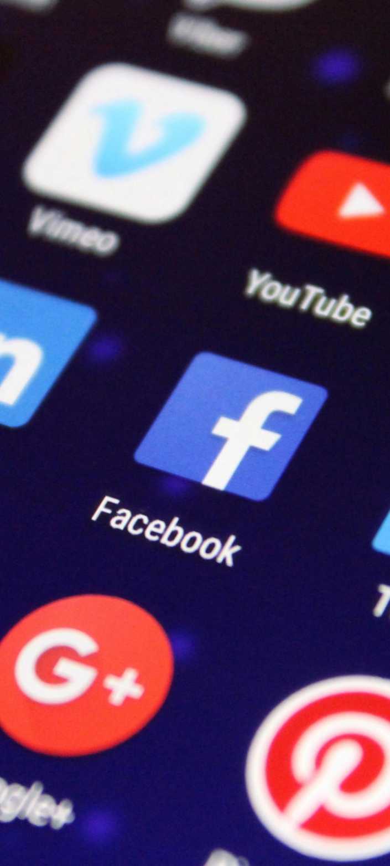
INTERNET & SOCIAL MEDIA REVOLUTION

Slide 2
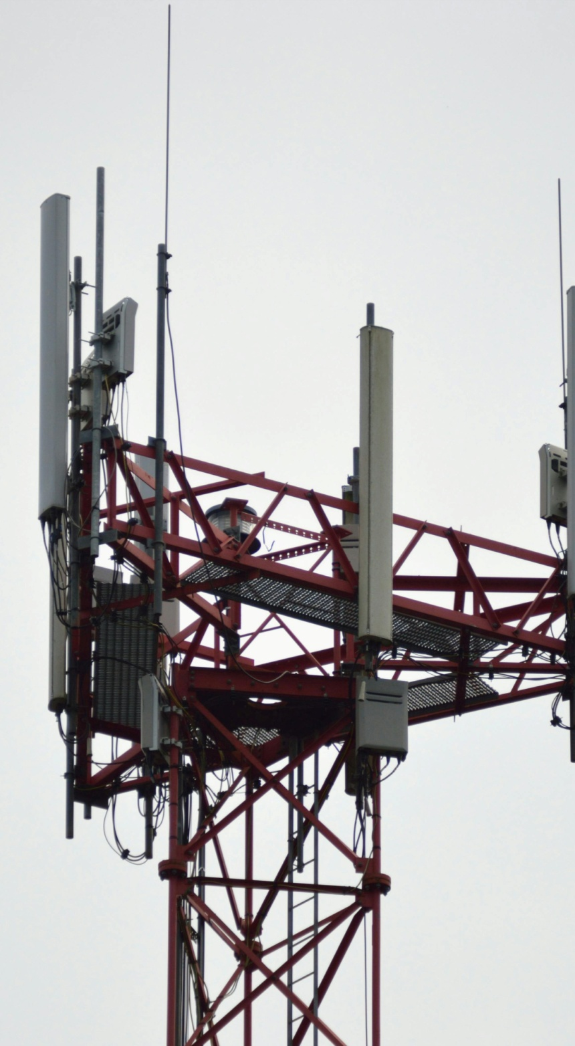
INTERNET AND IT’S THING
"The Internet is becoming the town square for the global village of tomorrow.“-bill gets

Slide 3
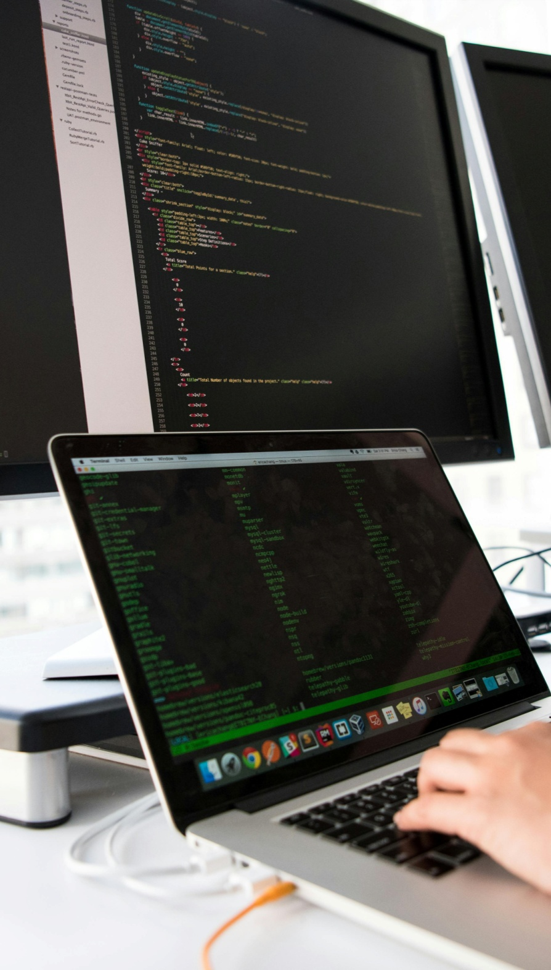
WHAT IS INTERNET
Definition & Basics
Internet technology refers to the hardware, software, and protocols that enable global communication and data exchange over the internet.
Web Technologies
Includes web browsers, search engines, websites, and cloud computing that allow users to access and share information.

Slide 4
Revolution web!!
Birth of the Internet (1960s–1980s)
Started as ARPANET in the 1960s for military communication.
Development of TCP/IP (1983) made global networking possible.
World Wide Web (1990s)
Tim Berners-Lee introduced the WWW in (1991),
Growth of web browsers, emails, and search engines like Google revolutionized information access.
5G, AI & Future Innovations (2020s & Beyond)
5G technology is making internet speeds ultra-fast.
AI, blockchain, and metaverse are shaping the future of digital connectivity.

Slide 5
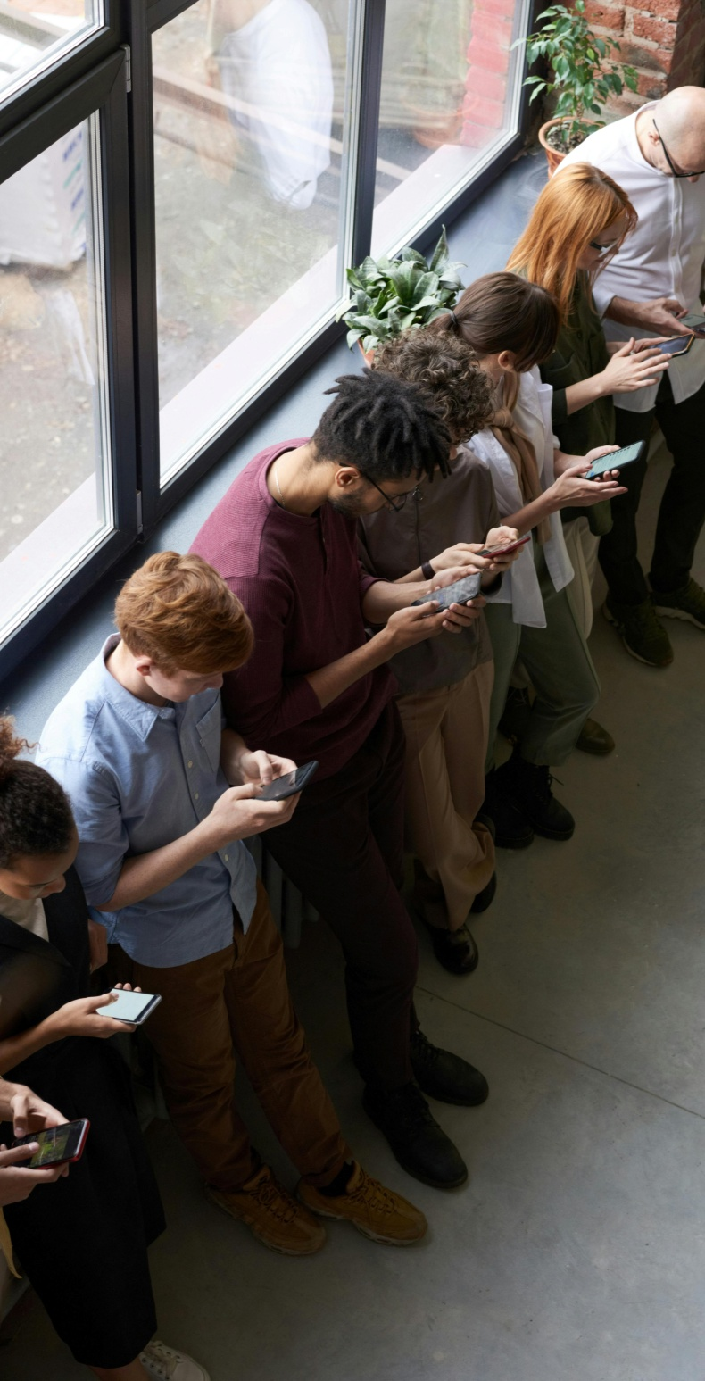
Social media
"Social media creates communities, not markets."
– Don Schultz

Slide 6
What is social media
Definition & Purpose
Social media refers to digital platforms and apps that enable users to create, share, and interact with content online.
Types of Social Media
Includes social networking (Facebook, LinkedIn), microblogging (Twitter/X), photo & video sharing (Instagram, YouTube, TikTok), and messaging apps (WhatsApp, Telegram).
Impact on Communication
Enables instant global connectivity, breaking geographical barriers and promoting real-time conversations.

Slide 7
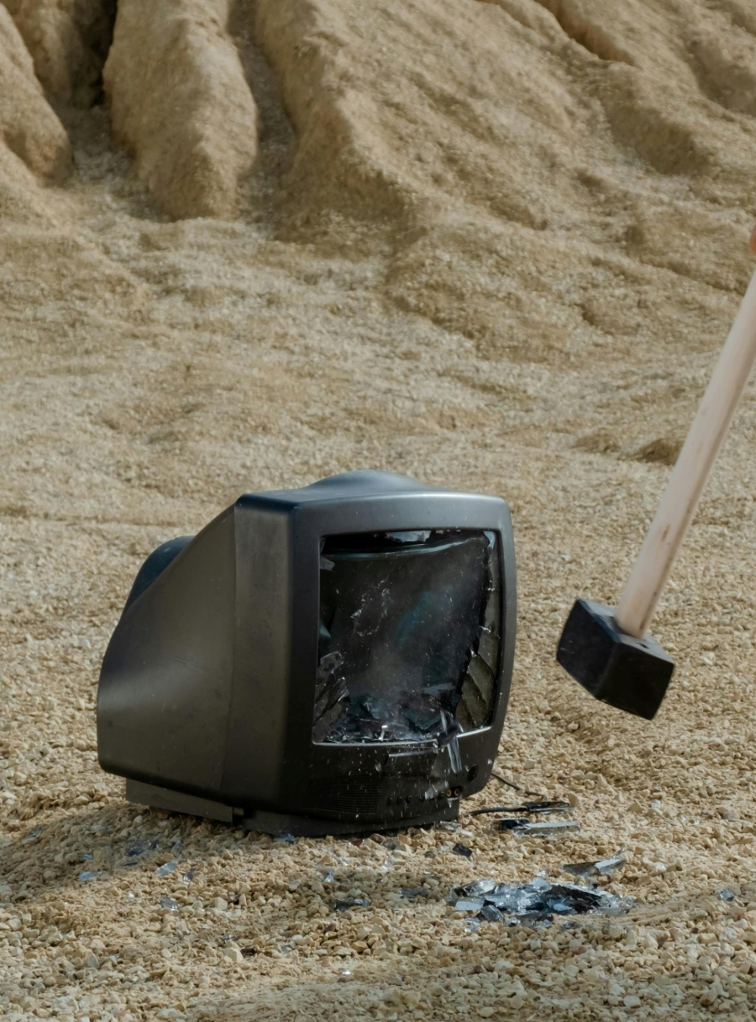
ADV & DISA OF SOCIAL MEDIA AND INTERNET
"We don’t have a choice on whether we do social media, the question is how well we do it.
– Erik Qualman

Slide 8

ADVANTAGES OF INTERNET AND SOCIAL MEDIA
The internet and social media revolution For Individuals: 1. Global Connectivity and Communication 2. Mental Health Support 3. Social Movements and Activism For Businesses: 1. Marketing and Advertising 2. Global Reach 3. Data Collection and Analysis For Society: 1. Education and Learning 2. Cultural Exchange and Understanding 3. Disaster Response and Emergency Communication

Slide 9

DISADVANTEGES OF INTERNET AND SOCIAL MEDIA
The internet and social media revolution Privacy Concerns: 1. Data Collection and Exploitation 2. Vulnerability to Data Breaches 3. Lack of Control Misinformation and Fake News: 1. Rapid Spread 2. Difficulty in Verification Addiction and Time Consumption: 1. Compulsive Behavior 2. Lost Productivity

Slide 10
EFFECT OF INTERNET AND SOCIAL MEDIA

Slide 11

POSITIVE EFECT OF SOCIAL MEDIA AND INTERNET
• The internet and social media have fostered global communities through increased communication and information sharing.
• New business models and economic opportunities have emerged, while social media facilitates activism and awareness of important issues.
• Additionally, access to vast educational resources is now readily available.

Slide 12
NEGATIVE EFECT OF SOCIAL MEDIA AND INTERNET
• Social media's rapid information spread contributes to misinformation and disinformation, including fake news and conspiracy theories.
• Privacy concerns arise from the platforms' extensive data collection.
• Excessive use is associated with negative mental health effects like anxiety and depression.
• Finally, cyber bullying and harassment are prevalent on social media.

Slide 13
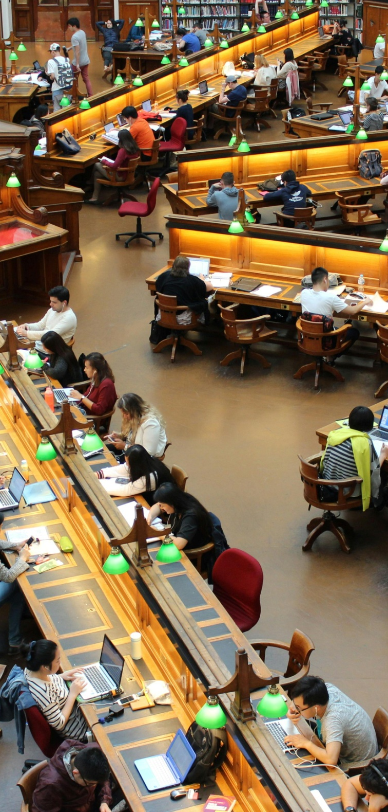
How to Use Social Media Properly

Slide 14
BAD OR GOOD !!
Maintain Privacy & Security
Use strong passwords and enable two-factor authentication (2FA).
Adjust privacy settings to control who can see your posts.
Think Before You Post
Avoid sharing misinformation, personal details, or offensive content.
Remember, what you post stays on the internet forever.
Use Social Media for Growth
Follow educational pages, industry experts, and positive influencers.
Engage in networking, skill-building, and learning opportunities.
Balance Screen Time
Avoid excessive scrolling and set time limits to prevent addiction.
Focus on real-life interactions and offline activities.
year | users
2000-2010 | 970 million
2010-2014 | 2 billion
2014-2020 | 4.39 billion
2020-2024 | 5.07 billion

Slide 15
10THINGs TO LEARN ABOUT SOCIAL MEDIA
Social Media is Powerful
Connects billions of users globally and influences opinions, trends, and businesses.
Privacy Matters
Always check and update your privacy settings to control who can see your information.
Misinformation Spreads Fast
Verify facts before sharing; fake news can have serious consequences.
Your Digital Footprint is Permanent
Everything you post stays online, even if deleted. Think before you post!
Social Media Affects Mental Health
Excessive use can lead to anxiety, depression, and comparison stress. Use it wisely.

Slide 16
CONTINUE-
It’s a Marketing & Business Tool
Businesses use platforms like Instagram, LinkedIn, and Facebook for branding and sales.
Cyber security is Essential
Use strong passwords, enable two-factor authentication (2FA), and beware of scams.
Social Media Algorithms Control What You See
Platforms show content based on your behavior, influencing your opinions and preferences.
It Can Be Addictive
Endless scrolling and notifications can be distracting. Set screen time limits.
It Can Be Used for Positive Change
From social activism to fundraising, social media has the power to bring people together for a cause.

Slide 17
Thanks for your time
"The key is in not spending time, but in investing it."
– Stephen R. Covey

